Slide 1




Adam Beck
Software Engineer, Zendesk
@adsa_b
Notes:
Hi I’m Adam and I’m a software engineer at Zendesk.
I work on a product called Connect, but that’s not what I’m here to talk about.
I’m here to give an introduction to functional programming.

Slide 2
Who Am I?

Slide 3
ES6 Primer
Notes:
With that, let’s get into it.
Just incase someone doesn’t know some of the new syntax in javascript, here is a quick primer on it.

Slide 4
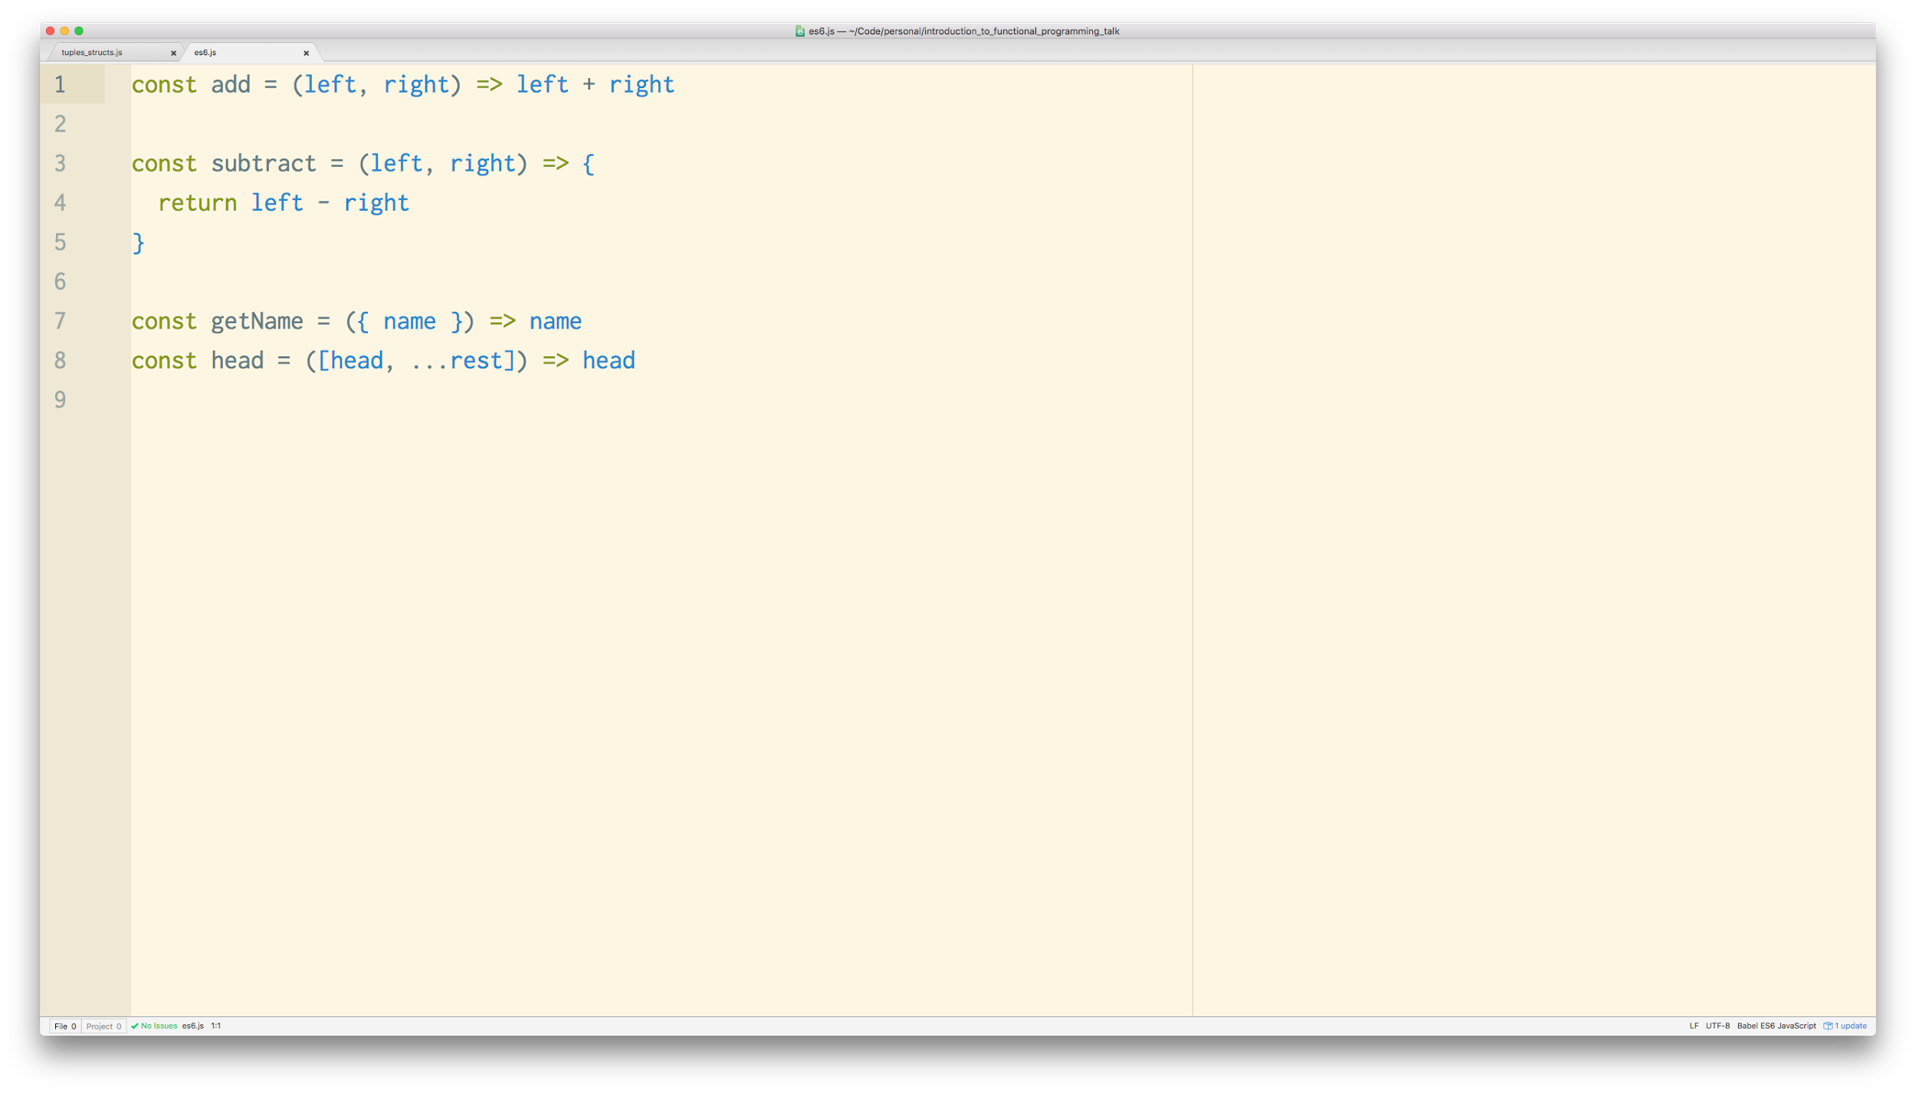
Notes:
Arrow functions, big and small
Deconstructing
Splat / rest deconstructing

Slide 5
What is Functional Programming?
Notes:
One of the most often asked questions about functional programming is, what is it? It’s not an easy one to answer. With object oriented programming, everything is well defined, everything is in it’s place. Object oriented programming was derived by programmers for programmer. However, functional programming has a large basis in crazy math theory and borrows heavily. Now, don’t get discouraged if you’re not good at math. Neither am I, in fact, that’s the only time I’ll be mentioning math today. So functional programming is about three things. Functions, Data models, and what those functions do to those data models.
The rest of it is how you apply those functions to that data. In Todays talk, we’ll be touching on a few design patterns, and some of the core aspects of functional programming.

Slide 6
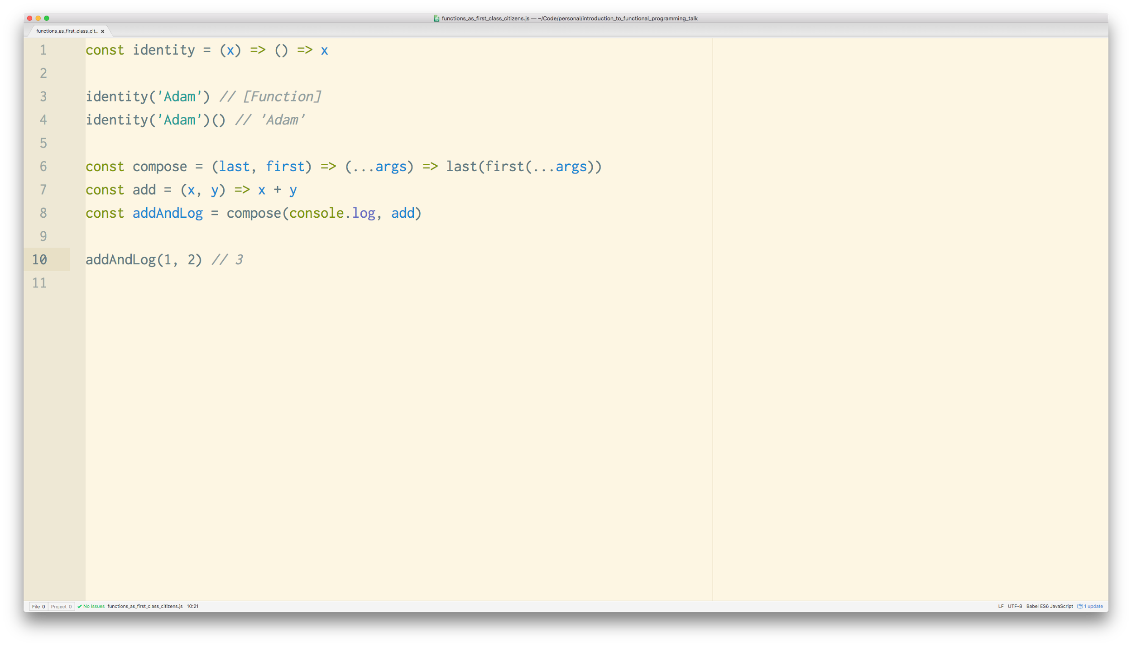
Notes:
Thankfully JavaScript is an excellent functional language because you can do all of those things.
What you see here is actually a small overview of what we’ll be touching on in todays talk.
We wlll be touching on
Currying, which is where we return a function from another function
Higher order functions - Functions that take functions or return a function
Functional Composition - Combining multiple functions together to create one larger function
Functional purity - a technique where functions don’t cause any side effects, and always return the same output given the same input
It’s actually really common to assign functions to objects or variables in javascript, it’s also super common to pass functions to other functions. Like callbacks.

Slide 7
Functions as First Class Citizens
Notes:
As the name implies, functions are a key part of functional programming. In order to even start with functional programming we need to treat functions as first class citizens. What this means is that we should be able to
Assign functions to variables
Pass functions as parameters to other functions
Return functions from other functions

Slide 8
Notes:
To return to our overview example, we’re treating functions as first class citizens all over the joint.
We’re
Returning functions as return values
Taking functions as parameters
And assigning functions to variables
This type of treatment of functions is a fundamental part of functional programming. Being able to treat functions as first class citizens is a property of a language and less of design decision of an engineer.

Slide 9
Higher Order Functions
Map, Filter, Reduce
Notes:
Being able to do these things with functions enables us to take functions as parameters or return functions as return values. These types of functions are called Higher Order Functions. The most popular of which are Map, Filter and Reduce.
Thankfully, these functions already exist in javascript

Slide 10
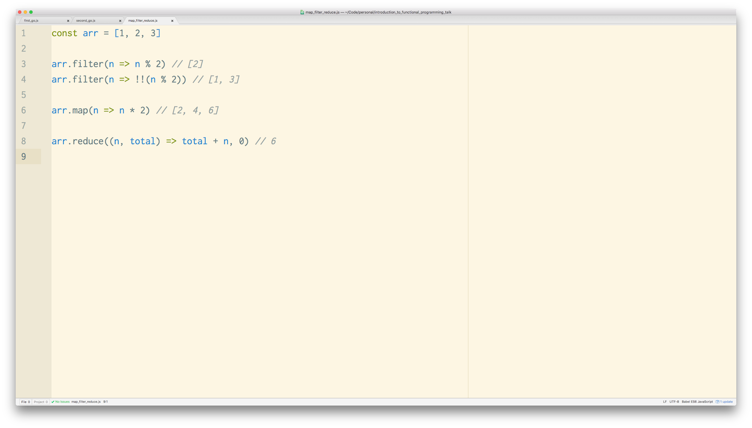
Notes:
They already exist on the Array prototype.
So what do they do?
Well,
Filter, as the name implies, will filter the array.
The way that it works is that it takes a function,
and it will call that function, passing in current element in the array.
The provided function is expected to return a boolean.
If the return value is true, this says ‘yes I want to keep this element’.
However, if we return false, it will remove that element from the array.
As you can see in the example, if I use modulus to check if each number is even, I will get an array back with the number 2 inside of it
Before I go any further, I’m just going to air my own opinion about functional programming. I HATE the way everything is named in functional programming. I said earlier that OO was made by programmers, for programmers. That really comes through with how everything is layed out and named. Very organised and senceacle most of the time. However, Functional programming comes from a bunch of MIT scientists that thought using math theory names for every was a great idea. Functional programming naming is horrid.
Ok, so, back to the slides
Map, this name doesn’t really imply much so lets head to the example
What map does is that it takes a function
It calls that function for each element in the array, just like filter
However, this time we’re allowed to return whatever we want
So in this case, if we double all of the numbers in the array we get an array back that has the doubled numbers in it.
Lastly, lets touch on reduce
While the name is slightly better than map, reduce is a bit funny.
The idea behind map and filter is that you would massage a collection of data into a shape you like
This could be a list of use id’s that get turned into user objects, or a list of strings that get the profanity stripped out.
Where reduce comes in is when we want to turn our collection into a single piece of data
Maybe we want to merge all of your user objects together because they represent a group of users, or maybe you’re adding up the number of profanity found
The way reduce works is
It takes a function and then a starting or default value, in this case 0.
On the first iteration, the we’re given the current element in the array, and the default value.
On all subsequent iterations we’re given the previously returned value, and the current element of the array
I know that reduce can sound like black magic, and it can also look like it, so lets step through it.

Slide 11
Function Composition
Notes:
Next, we’ll be going over function composition. Really, this is just a fancy way of taking multiple functions, and turning them into one large function.
So let’s run through a couple of examples of what that looks like

Slide 12
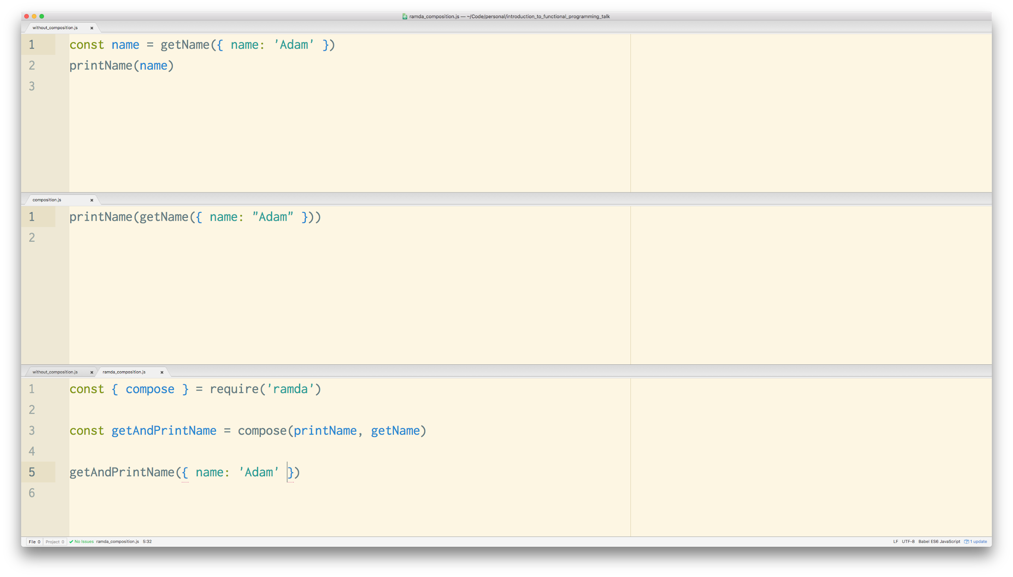
Notes:
So on the very top, I have a function that get’s the name property off of an object. We then assign that name to a const, and then pass it into a function that prints that name. Pretty boring stuff.
In the middle, im calling getName, and then the output of genName is being sent into printName. This is function composition. That’s it. You line up your functions in a chain. Your first function gets the initial input, and then it sends it’s return value to the next function. And so on, until it gets to the end of the chain.
However, if we look closely we can see that all the code in the second example is being executed immediately. In most functional languages there is a way to build these functions up in a chain and execute it later.
In our last example, we use a the ramda library to do this for us, because JavaScript lacks that functionality. Traditionally, this is how function composition is done. You pass a series of functions to a higher order function that lines them all up, from right to left.
It then returns another function.
Then when this function is called, it kicks off the chain of functions that you originally passed in. Sending the output from one to another.
So where is this useful? Functional programming is built up of a lot of tiny, generic functions that do very little on their own. However, chained together, they can be very powerful.

Slide 13
Functional Purity
Notes:
Next, we’ll touch on functional purity. Arguable one of the hardest, and most useful things in functional programming.
Functional purity, or pure functions are functions whose output is derived from their input. Meaning, that if I have a function that takes two numbers and adds them together, then I should always get the same value as long as the input stays the same.

Slide 14
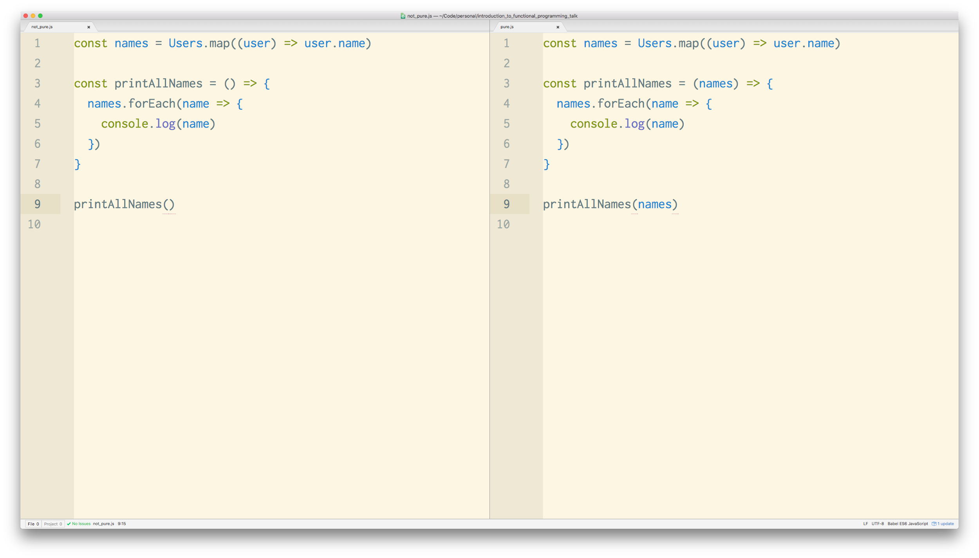
Notes:
Pure functions promise a couple of things
The returned value won’t change if you don’t change the input
They don’t keep state
Imagine if you had a function that, on first run returned one value, and then on the second run returned something completely different. I don’t know about you but that would make me curl up into a ball.
Lets look at our examples for an idea of what inpure functions and pure functions look like. On the left and right we have a function that prints all of our users names. However, they’re doing it very differently. On the left we have an inpure function. The printAllNames functions is referencing the names array. This array sits outside of the function and could change. The printAllNames function has no control over that array.
On the right we have the same function, however we’re taking the names as a parameter. Because we’re taking the names as a parameter, the function now has a bit of control over the array.
The function on the left is reaching outside of its bounds. It’s expecting the system to be in a specific state and because it has no control over that array, we can’t guarantee it. On the right, the function isn’t concerned with anything else except about what’s going on inside of it. It doesn’t expect the system to be in any state, it just wants an array of names.
So, what’s so great about this subtle change?
Not only are we declaring all of our dependencies up front, but we’ve also made the function extremely testable. We no longer have to change some global state to test this function, instead we can just pass whatever we want in, and make assertions based on its output.

Slide 15
Currying and Partial Application
Notes:
Woo, alright. Take a breath. We’re onto our last section here.

Slide 16
Partial Application
Notes:
First up, partial application.
Partial application is where you only provide SOME of a functions arguments, and get a new function back to call later.

Slide 17
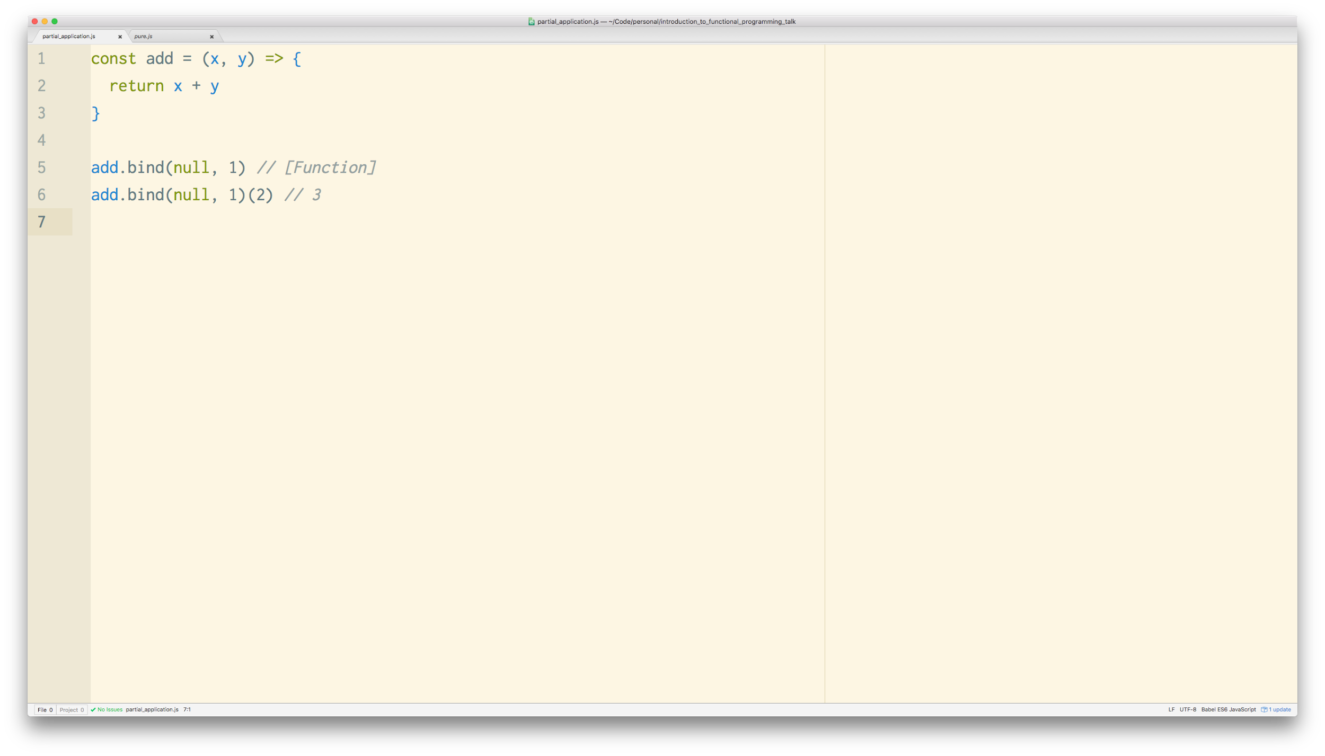
Notes:
Thankfully, JavaScript has this too with the bind function. So, exists on the Function prototype. It takes at least one argument. The ‘this’ context the function will execute in. All arguments after that are provided to the original function. Bind will then return a new function that will call the original function with the provided arguments.
In a way, we’re priming the arguments for a function. We’re partially applying the function. We’re telling it, ‘hey these are the arguments I have now, I might have some later’
Next, any arguments we pass to the new function, will also be sent to the original function.
Partial application lets us prime a function with arguments, and then call it with those later.
It also lets us to provide any missing arguments at that point. You might be wondering why this is useful, but imagine if you had some sort of API function. Maybe you have the API parameters you need, but you want to wait until another function is done? Partially apply it, and compose it.

Slide 18
Currying
Notes:
Next we have partial applications sibling, currying.

Slide 19
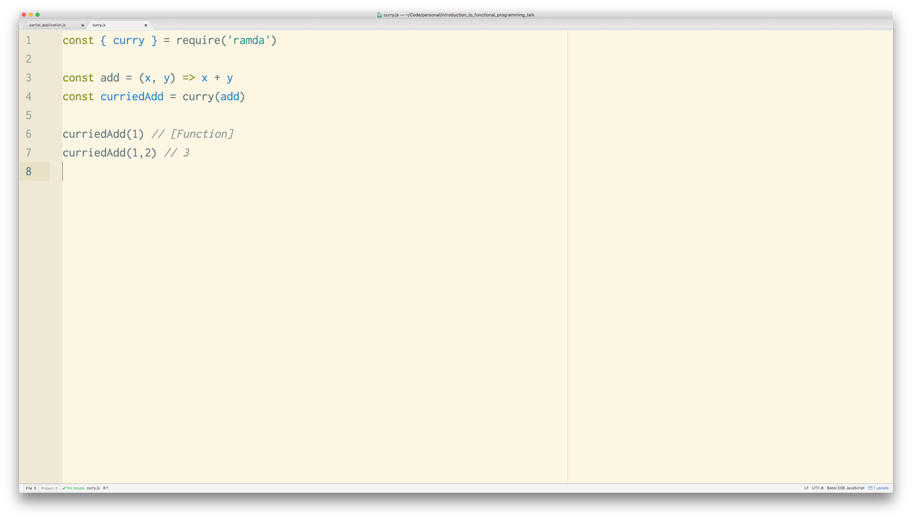
Notes:
Currying is very similar to partial application, except when a function is curried it knows how many parameters is takes, and will automatically execute when it receives them.
You can also partially apply curried functions.
If you look at this example it’s almost identical to our last example, except we’re passing our add function to the higher order curry function. It returns a curried version of our function.
If we only provide one argument, it returns a function that will take the remaining arguments. If we provide two arguments, it knows that we’ve provided all the arguments, so it executes the original function and returns the result.
Typically, currying is what we normally use when we want to do partial application or any type of argument caching. However, partial application is a side effect of currying.

Slide 20
Bringing It All Together
Notes:
We made it! So now we’re going to take everything we’ve learned and apply it to a small example.

Slide 21
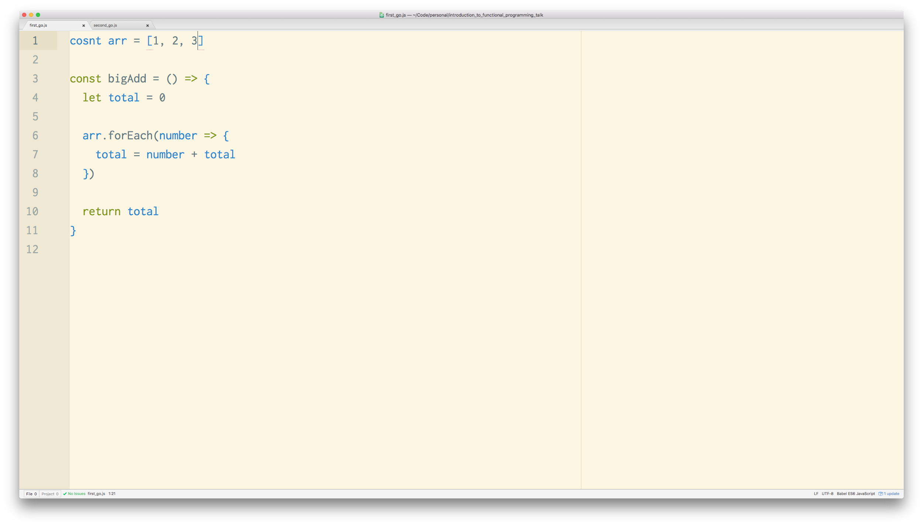
Notes:
Impure outter
Impure inner
Non-generic add function
forEach is a sign that something impure is going on

Slide 22
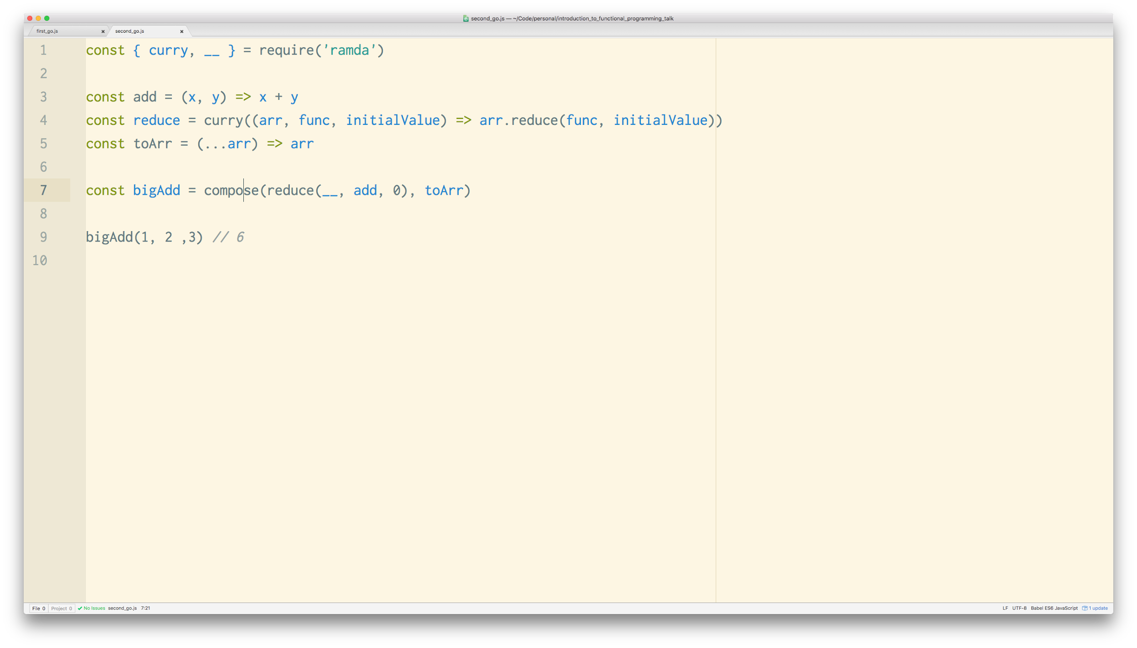
Notes:
Break down each step into it’s own function
Small, generic building blocks that can be combined
Currying holes

Slide 23
Real Refactoring
Old - New
Notes:
We made it! So now we’re going to take everything we’ve learned and apply it to a small example.

Slide 24
Pros - Cons
JS is welcoming
Ecosystem is rich
Pure functions make testing easy
Team buyin
Gated behind terrible naming

Slide 25
Notes:
Higher order functions - Functions that take functions or return a function
Functional Composition - Combining multiple functions together to create one larger function
Functional purity - a technique where functions don’t cause any side effects, and always return the same output given the same input
Currying, which is where we return a function from another function

Slide 26
Adam Beck
Software Engineer, Zendesk
@adsa_b
Notes:
Hi I’m Adam and I’m a software engineer at Zendesk.
I work on a product called Connect, but that’s not what I’m here to talk about.
I’m here to give an introduction to functional programming.

